Slide 1

Point registration via efficient convex relaxation
Haggai Maron, Nadav Dym, Itay Kezurer, Shahar Kovalsky, Yaron Lipman
Weizmann Institute of Science

Slide 2





Orthogonal Procrustes Problem
Orthogonal
$$Q$$
$$P$$
$$RP$$
$$≈$$
Correspondences $↔$ Easy Problem

Slide 3
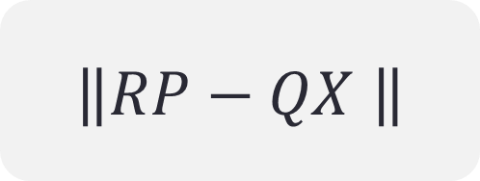





Procrustes matching (PM)
Orthogonal
Permutation
$$QX$$
$$RP$$
$$P$$
$$≈$$
$$Q$$
$$\left\|RP−QX \right\|$$

Slide 4


Procrustes matching (PM)
Find $X,R$ minimizing
$$\left\|RP−QX\right\|$$
Orthogonal
Given
Point clouds
Orthogonal
Permutation

Slide 5
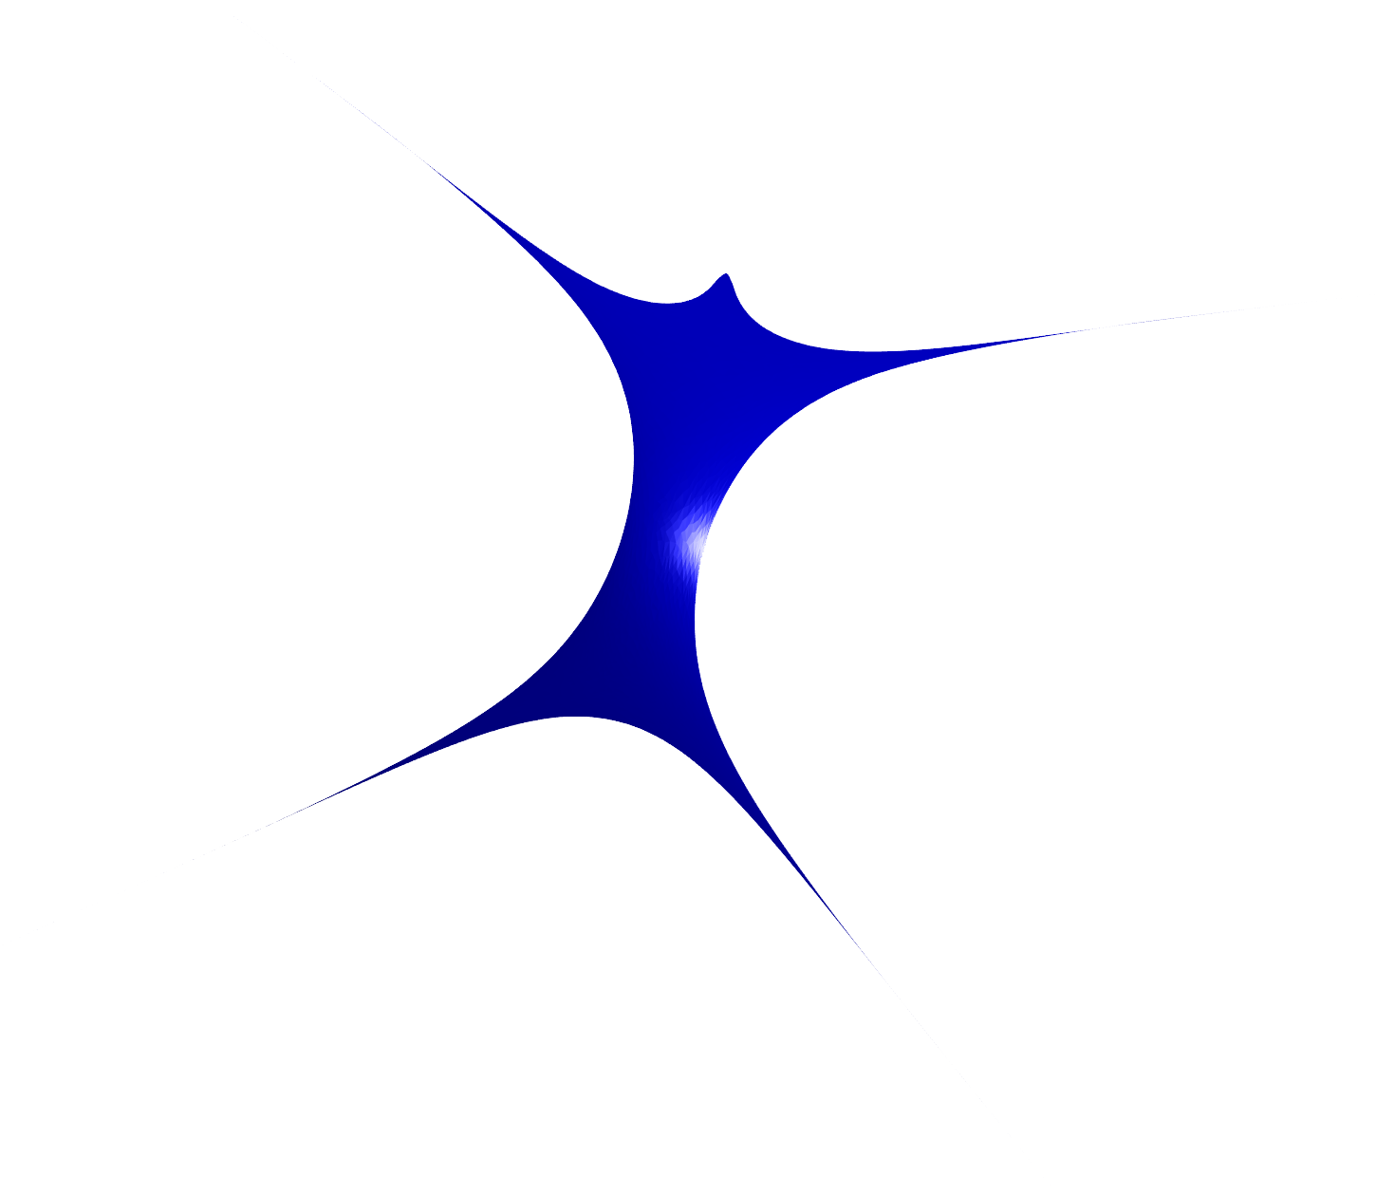

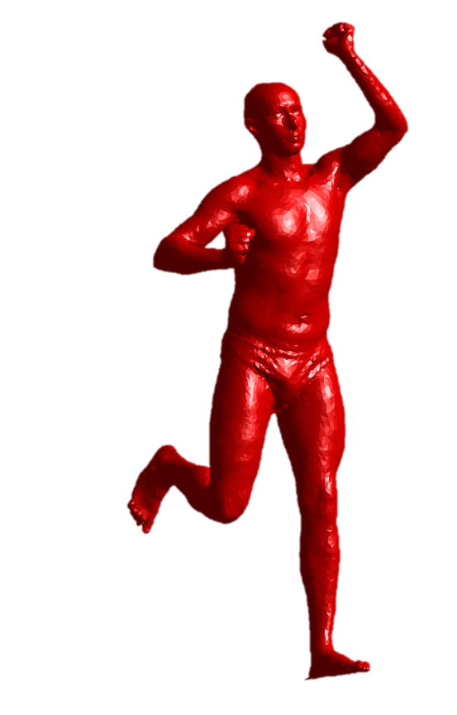
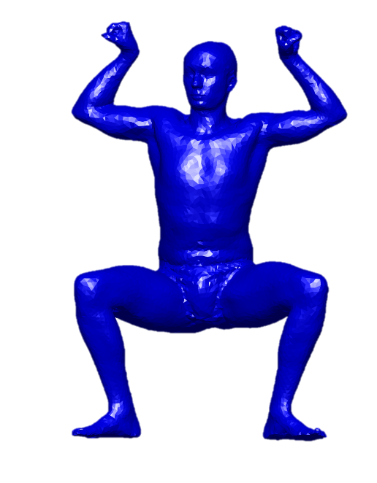
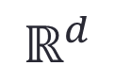
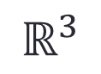
Motivation
$$ℝ^{3}$$
$$ℝ^{d}$$
embedding
3D Non Rigid Alignment
High dimensional Rigid Alignment
[Jain et al. 2006, Ovsjanikov et al. 2008]

Slide 6
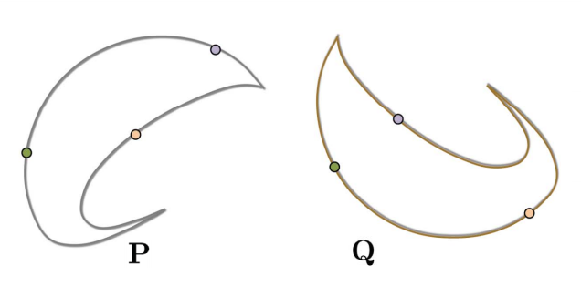
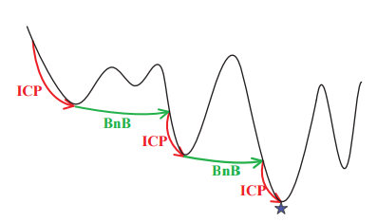
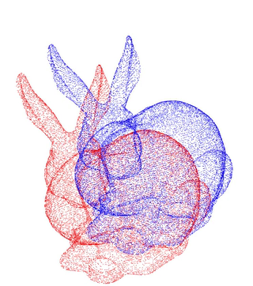
Previous work: Low dimensional PM
RANSAC
[Fischler and Bolles 1981]
Exponential in the dimension
Combinatorial optimization
[Gelfand et al. 2005, Yang et al. 2013]
Worst case: exponential
ICP
[Besl and Mckey 1992]
Only local minimum guaranteed

Slide 7
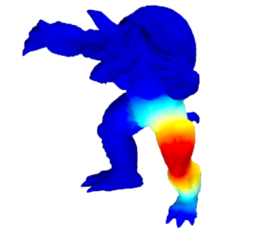
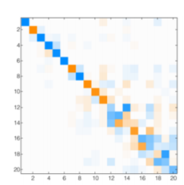
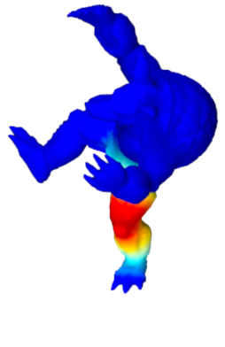
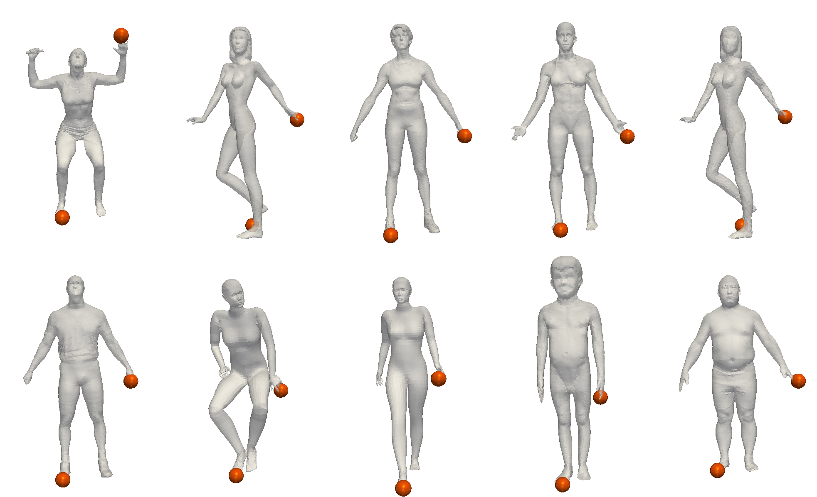
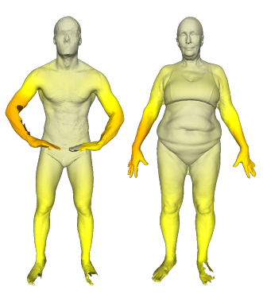
Previous work: Shape matching
Functional maps
[Ovsjanikov et al. 2012]
Depends on functional correspondences
SDP relaxations
[Kezurer et al. 2015]
Works for small-scale problems
LP relaxations
[Chen and Koltun, 2015]
Relies on extrinsic alignment

Slide 8




$\text{Bottom} \text{Line}$:
$$\text{High} \text{d}\text{imensional} \text{PM} \text{is} \text{an} \text{open} \text{challenge}$$
$$ℝ^{d}$$

Slide 9

Convex Relaxation
$$\left\|RP−QX\right\|$$
Orthogonal
Permutation

Slide 10
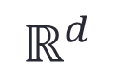
Convex Relaxation
$$ℝ^{d}$$
PM
Convex
Superset

Slide 11
Convex Relaxation
$$\left\|RP−QX\right\|$$
Slow
&
Tight
LP
SDP
Fast
&
Loose
PM

Slide 12

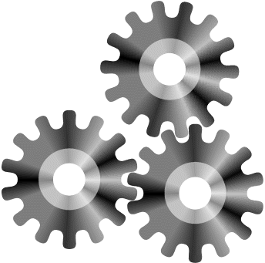

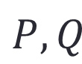
Why SDP relaxation?
Theorem:
If No noise, No symmetries
Then SDP relaxation is exact!
SDP
Optimal $X,R$
$$P,Q$$

Slide 13
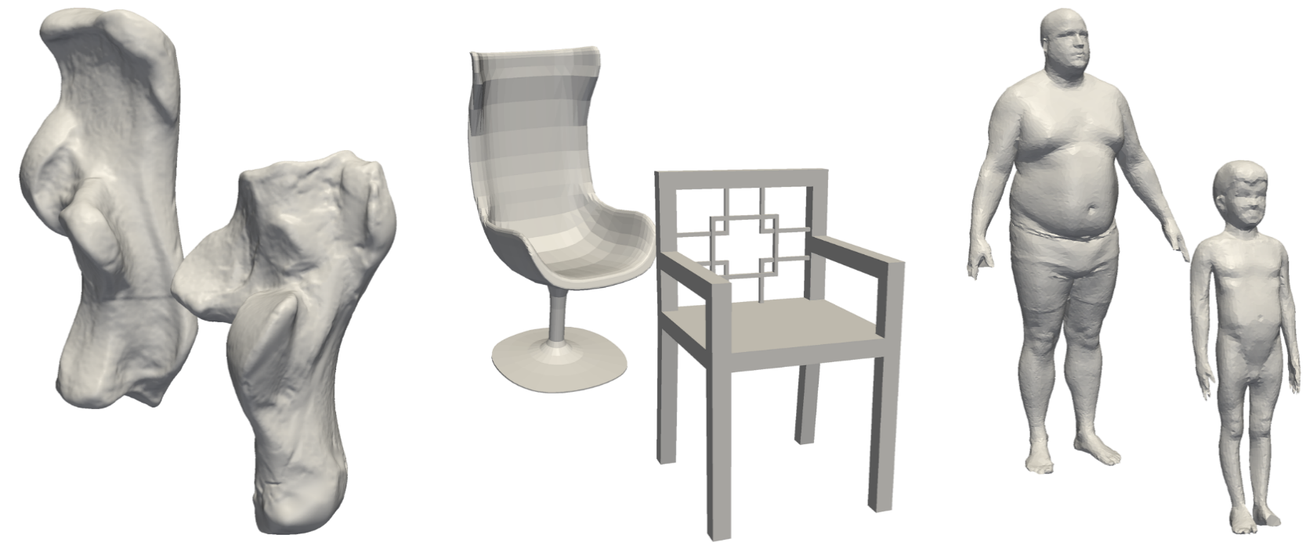
Why SDP relaxation?
Theorem:
If No noise, No symmetries
Then SDP relaxation is exact!
No symmetries?

Slide 14
Why SDP relaxation?
Theorem:
If No noise, bilateral symmetries
Then SDP relaxation is exact!

Slide 15
Our Approach
Use SDP relaxation for real problems
Idea: exploit PM structure
SDP
PM

Slide 16
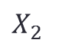
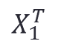
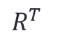

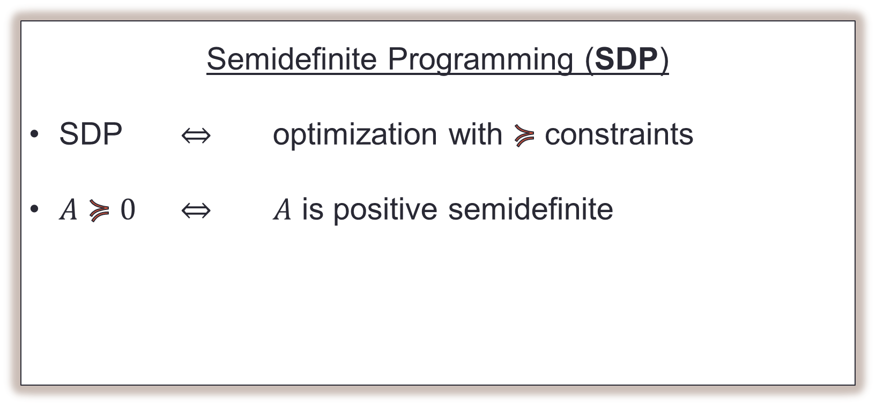

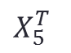
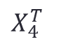

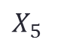

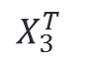
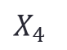


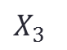
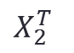
minimize $\left\|RP−QX\right\|$
1
$$X_{1}^{T}$$
$$X_{2}^{T}$$
$$X_{3}^{T}$$
$$X_{4}^{T}$$
$$X_{5}^{T}$$
$$R^{T}$$
$$Y$$
$$X_{1}$$
$$X_{2}$$
$$X_{3}$$
$$≽0$$
$$X$$
$$X_{4}$$
$$X_{5}$$
$$R$$
$$R$$

Slide 17
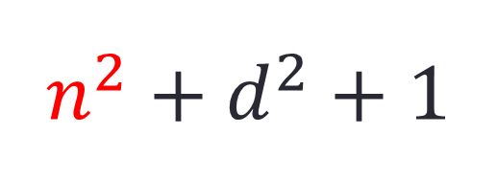
minimize $\left\|RP−QX\right\|$
1
$$X_{1}^{T}$$
$$X_{2}^{T}$$
$$X_{3}^{T}$$
$$X_{4}^{T}$$
$$X_{5}^{T}$$
$$R^{T}$$
$$Y$$
$$X_{1}$$
$$X_{2}$$
Huge!
$$n^{2}+d^{2}+1$$
$$X_{3}$$
$$≽0$$
$$X_{4}$$
$$X_{5}$$
# points
dimension
$$R$$

Slide 18

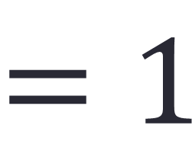
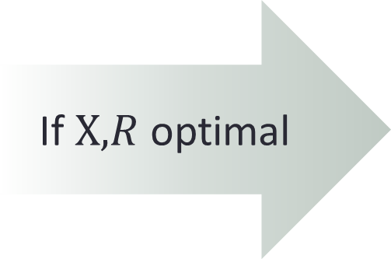
minimize $\left\|RP−QX\right\|$
If $X,R$ optimal
1
$$X_{1}^{T}$$
$$X_{2}^{T}$$
$$X_{3}^{T}$$
$$X_{4}^{T}$$
$$X_{5}^{T}$$
$$R^{T}$$
$$Y$$
$$X_{1}$$
$$X_{2}$$
$$rank$$
$$X_{3}$$
$$=1$$
$$X_{4}$$
$$X_{5}$$
$$R$$

Slide 19
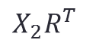
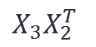
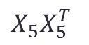
minimize $\left\|RP−QX\right\|$
1
$$X_{1}^{T}$$
$$X_{2}^{T}$$
$$X_{3}^{T}$$
$$X_{4}^{T}$$
$$X_{5}^{T}$$
$$R^{T}$$
$$X_{1}$$
$$X_{2}$$
$$X_{2}R^{T}$$
$$rank$$
$$X_{3}$$
$$X_{3}X_{2}^{T}$$
$$=1$$
$$X_{4}$$
$$X_{5}$$
$$X_{5}X_{5}^{T}$$
$$R$$

Slide 20
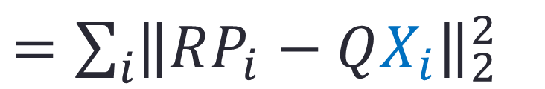
minimize $\left\|RP−QX\right\|$
$=\sum_{i}{{\left\|RP_{i}−QX_{i}\right\|}_{2}^{2}}$
1
$$X_{1}^{T}$$
$$X_{2}^{T}$$
$$X_{3}^{T}$$
$$X_{4}^{T}$$
$$X_{5}^{T}$$
$$R^{T}$$
$$X_{1}$$
$$X_{2}$$
$$X_{3}$$
$$X_{4}$$
$$X_{5}$$
$$R$$

Slide 21

minimize $\left\|RP−QX\right\|$
$=\sum_{i}{{\left\|RP_{i}−QX_{i}\right\|}_{2}^{2}}$
1
$$X_{1}^{T}$$
$$X_{2}^{T}$$
$$X_{3}^{T}$$
$$X_{4}^{T}$$
$$X_{5}^{T}$$
$$R^{T}$$
$$X_{1}$$
$$X_{2}$$
$$X_{3}$$
$$X_{3}X_{2}^{T}$$
$$X_{4}$$
$$X_{5}$$
$$R$$

Slide 22

minimize $\left\|RP−QX\right\|$
$=\sum_{i}{{\left\|RP_{i}−QX_{i}\right\|}_{2}^{2}}$
1
$$X_{1}^{T}$$
$$X_{2}^{T}$$
$$X_{3}^{T}$$
$$X_{4}^{T}$$
$$X_{5}^{T}$$
$$R^{T}$$
$$X_{1}$$
$$X_{2}$$
$$X_{3}$$
$$≽0$$
$$X_{4}$$
$$X_{5}$$
$$R$$

Slide 23
23
1
$$X_{1}^{T}$$
$$X_{2}^{T}$$
$$X_{3}^{T}$$
$$X_{4}^{T}$$
$$X_{5}^{T}$$
$$R^{T}$$
$$X_{1}$$
$$X_{2}$$
$$X_{3}$$
$$≽0$$
$$X_{4}$$
$$X_{5}$$
$$R$$

Slide 24
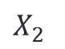
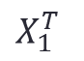
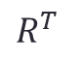
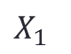
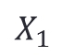

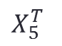
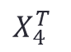

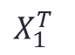
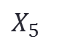
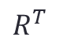
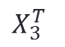



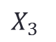
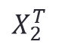
24
1
$$X_{1}^{T}$$
$$R^{T}$$
$$X_{1}$$
$$≽0$$
1
$$X_{1}^{T}$$
$$X_{2}^{T}$$
$$X_{3}^{T}$$
$$X_{4}^{T}$$
$$X_{5}^{T}$$
$$R^{T}$$
$$X_{1}$$
$$R$$
$$X_{2}$$
$$X_{3}$$
$$≽0$$
$$X_{4}$$
$$X_{5}$$
$$R$$

Slide 25
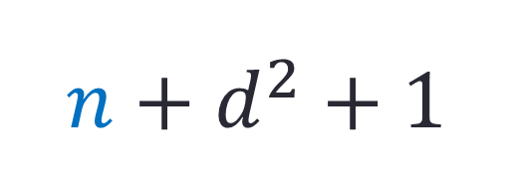
25
1
$$X_{1}^{T}$$
$$R^{T}$$
$$n+d^{2}+1$$
$$X_{1}$$
$$≽0$$
1
$$X_{1}^{T}$$
$$X_{2}^{T}$$
$$X_{3}^{T}$$
$$X_{4}^{T}$$
$$X_{5}^{T}$$
$$R^{T}$$
$$X_{1}$$
$$R$$
$$X_{2}$$
$$X_{3}$$
$$≽0$$
$$X_{4}$$
$$X_{5}$$
$$R$$

Slide 26






26
1
$$X_{1}^{T}$$
$$R^{T}$$
$$X_{1}$$
$$≽0$$
1
$$X_{1}^{T}$$
$$X_{2}^{T}$$
$$X_{3}^{T}$$
$$X_{4}^{T}$$
$$X_{5}^{T}$$
$$R^{T}$$
$$X_{1}$$
$$R$$
$$X_{2}$$
$$⋮$$
$$X_{3}$$
$$≽0$$
$$X_{4}$$
1
$$X_{5}^{T}$$
$$R^{T}$$
$$X_{5}$$
$$X_{5}$$
$$≽0$$
$$R$$
$$R$$

Slide 27




Slow
Fast
Tight
Tight?
Notes:
So this is what we have:
On the left side we have the standard relaxation, which is slow but very tight.
On the other hand we have the efficient relaxation which faster since we have much smaller constraints, but is it as tight?

Slide 28
Theorem:
Equivalent Relaxations!

Slide 29



Theorem:
Equivalent Relaxations!

Slide 30

Scalability of PM-SDP

Slide 31


Results: Isometric matching
SCAPE dataset
Source
Target
[Anguelov at al. 05]

Slide 32



Isometric matching
SCAPE Raw Scans
Source
Target
[Anguelov at al. 05]

Slide 33



Non-Isometric matching
FAUST
% Correspondences
Intra subject
% Correspondences
Inter subject
Source
Target
[Bogo et al. 14]

Slide 34




Non-Isometric matching
SHREC 07’
Failure
[Giorgi et al. 07]

Slide 35





Limitations
Time $\sim 30m$($n\sim 100, d\sim 20$)
Highly non isometric
Topological differences

Slide 36



Summary
Structure $→$ efficiency
Exact recovery
State of the art results
$$RP=QX$$

Slide 37


Thank you!
Acknowledgments:
- European Research Council (ERC Starting Grant)
- Israel Science Foundation
Code Available online!
http://www.wisdom.weizmann.ac.il/~haggaim/
More results in the paper!
Anatomical classification
Collection alignment

